Slide 1
Human Environment- Adaptation
Presented by
Yogendra Anant
Guest lecture ( geography)

Slide 2
Eskimos
प्रस्तावना
अर्थ
निवास स्थान
शारिरिक लक्षण

Slide 3
निवास स्थान
This Photo by Unknown Author is licensed under CC BY-SA-NC

Slide 4
भोजन
शीतकालीन आखेट
बसंतकालीन आखेट
ग्रीष्मकालीन आखेट
वस्त्र
निवास के मकान
This Photo by Unknown Author is licensed under CC BY-SA

Slide 5
परिवहन के साधन
This Photo by Unknown Author is licensed under CC BY-SA

Slide 6
औजार
This Photo by Unknown Author is licensed under CC BY-SA

Slide 7
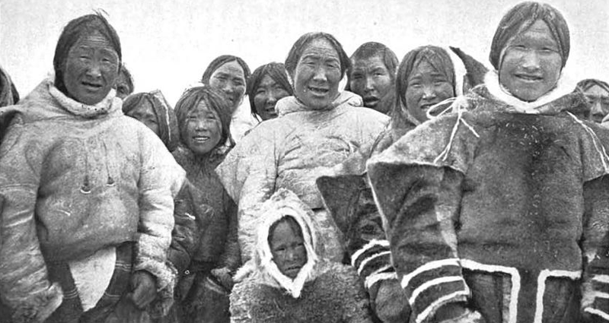
सामाजिक व्यवस्था एवं संस्कृति
This Photo by Unknown Author is licensed under CC BY-SA
This Photo by Unknown Author is licensed under CC BY-SA

Slide 8
This Photo by Unknown Author is licensed under CC BY

